Slide 1

New staff Orientation

Slide 2
Welcome!

Slide 3
Orientation Contents
What to Expect
About The Learning Lamp
Services for Families
Services for Schools
Important Employee Information

Slide 4
What to Expect
At The Learning Lamp, employees will find an atmosphere that reflects the passion of the nonprofit world, a deep commitment to learning and the drive of the business world.
It is a dynamic place that evolves to meet the changing needs of our families, schools and communities.

Slide 5
What to Expect
When you join our staff, you can count on challenging work that lets you use your current knowledge and acquire new skills.
We offer a responsive, friendly, team-oriented atmosphere with opportunities for professional development and career advancement.

Slide 6
What to Expect
The Learning Lamp is a mission-driven work environment.
We are committed to making a positive difference in the lives of young people.
We expect our employees to put the needs of kids first.
That means being engaged with students at all times.

Slide 7

About The Learning Lamp
The Learning Lamp was founded in 2003 with a simple idea– to provide high quality educational support services without a high price tag.

Slide 8
About The Learning Lamp
Dr. Lorraine Nulton, an educational psychologist, developed the idea for The Learning Lamp.
While evaluating students in Johnstown, PA area schools, she noticed that children who needed help the most often came from families who couldn’t afford the high cost of tutoring.
Start-up funding for The Learning Lamp was donated by the Nulton family.

Slide 9

About The Learning Lamp
The Learning Lamp has grown significantly since our launch in 2003.
We were founded to provide affordable, high quality one-to-one tutoring.
Today, our services include a variety of educational programs for families and schools.

Slide 10
About The Learning Lamp
The Learning Lamp is a nonprofit organization. Our mission is to engage children in the support they need to succeed.
Our vision is a community where all children have access to high quality education and the tools to succeed.
The Learning Lamp works in partnership with schools, families and community-based organizations to offer programs that make a positive impact on academic achievement.

Slide 11




About The Learning Lamp
United Way member agency in Bedford, Cambria and Somerset Counties.
One of only 53 nonprofits in PA to earn the Pennsylvania Association of Nonprofit Organizations’ Standards for Excellence certification.
GuideStar Exchange Gold Participant
Keystone STAR Level 4 child care provider

Slide 12
What is a Nonprofit?
A public benefit organization formed to serve a specific mission
Governed by a volunteer board of directors
Has no owners or investors
Surplus funds are reinvested into the mission of the organization

Slide 13
Our Mission Statement
The mission of The Learning Lamp is to engage all children in the support they need to succeed.

Slide 14
Our Values
Quality
Integrity
Transparency
Teamwork
Inclusive of all abilities
Responsive to the needs of the schools, children and families we serve

Slide 15
Our Values
The Learning Lamp offers quality educational programs that are inclusive of all children and responsive to the needs of schools, families and the community.
We are transparent and our operations are conducted in a way that demonstrates integrity and a commitment to teamwork.

Slide 16
Our Beliefs
All children can and must become engaged learners.
All children should have access to quality educational experiences that enhance and reinforce classroom learning.
Partnerships are critical to reaching students and developing programs that help them succeed.

Slide 17

Our Non-Negotiables
Every decision must benefit the children we serve.
Staff and volunteers who believe in our mission are critical to our success.

Slide 18
2014 at a Glance
The Learning Lamp served 19,748 children from 88 school districts and 46 non-public and private schools and other organizations.
We served students in 18 PA counties and two counties in Maryland.
Our fastest growing programs include child care, before and after school care, our Substitute Teacher Program and temporary staffing for schools.

Slide 19
Our Clients
The Learning Lamp has two distinct customer types:
  Families- We accept children of all abilities and income levels for child care, preschool, summer camps and tutoring.
  Schools- Managed under a new division called Ignite Education Solutions, we work in partnership with public and private schools, intermediate units and online learning organizations to provide educational services.

Slide 20

For Families
  One-to-one tutoring by certified teachers for as little as $13/hour
  SAT and ACT prep classes
  Quality, educationally-focused child care, preschool and before and after school care
  12 weeks of summer camp for grades PreK to 8
  Credit recovery and summer school

Slide 21

Child Care Centers
Jennerstown
Johnstown
Richland
Somerset
Westmont

Slide 22

School-age Programs
Cambria Heights Elementary
Cambria Elementary (Central Cambria SD)
Conemaugh Township Area Elementary
Forest Hills Elementary
Jackson Elementary (Central Cambria SD)
North Star Central Elementary
Richland Elementary
Saint Benedict School, Geistown
Windber Area Elementary
Also serve Westmont, Ferndale, Somerset and OMOS

Slide 23

Preschools
Bedford Area Elementary
Conemaugh Township Area Elementary
Everett Area Elementary
Jennerstown
Richland
Somerset
Westmont

Slide 24

For Schools
  88 districts and 46 non-public/private schools in 18 counties in Pennsylvania and 2 counties in Maryland
  Comprehensive services
  Flexible and cost-effective
  Work in partnership with schools to solve problems and find funds
  Serve grades PreK-12

Slide 25

For Schools
  School staffing services
  Substitute Teacher Program
  Fingerprinting services
  Classrooms for at-risk/special needs students
  Online learning
  Laurel Highlands Cyber Academy
  SAT prep
  The Learning Lamp To Go- Mobile science and geography workshops
  Tutoring and homebound instruction
  Professional Development

Slide 26


Substitute Teacher Program
  Admiral Peary AVTS
  Conemaugh Township Area SD
  Conemaugh Valley SD
  Greater Johnstown Career and Technology Center
  Richland SD
  Richland Academy
  Propel Charter Schools
  Shade-Central City SD
  Somerset Area SD
  Turkeyfoot Valley Area SD
  Tussey Mountain Area SD
  Windber Area SD

Slide 27

School Staffing Services
  Life skills/personal care aides
  Title 1 instructors
  Alternative education teachers
  Special education teachers
  Reading specialists
  Speech pathologists
  ESL teachers
  School psychologists
  LPNs
  Homebound instructors
  Online learning teachers

Slide 28

To Go Program
  Earth Balloon
  Discovery Dome
  LEGO Lab
  Giant Map of PA
  National Geographic Giant Maps
  KAPLA Kidstruction
  Geology Rocks!
  Bodies in Motion
  K’Nex and Kid N’Nex Workshops
  Imagination Playground

Slide 29

Laurel Highlands Cyber Academy
  129 students in 11 school districts (7 counties)
  Full-year and block schedules
  24/7 access to course content
  Aligned with PA Core Standards
  Courses taught by PA certified teachers

Slide 30

Like to Learn More?
Visit: thelearninglamp.org
Visit: igniteedu.org
Check out our video at: http://www.youtube.com/watch?v=lVoWKYcEelA
Join us on social media:

Slide 31
I’m Hired. Now What?
It’s time to complete the New Employee Orientation, which includes:
  Self-paced orientation slide show
  The Learning Lamp video
  Self-paced review of Employee Handbook
  Review of Offer Letter and Job Description
  Review of Training Check List
  Tour of worksite and assignment of mentor

Slide 32
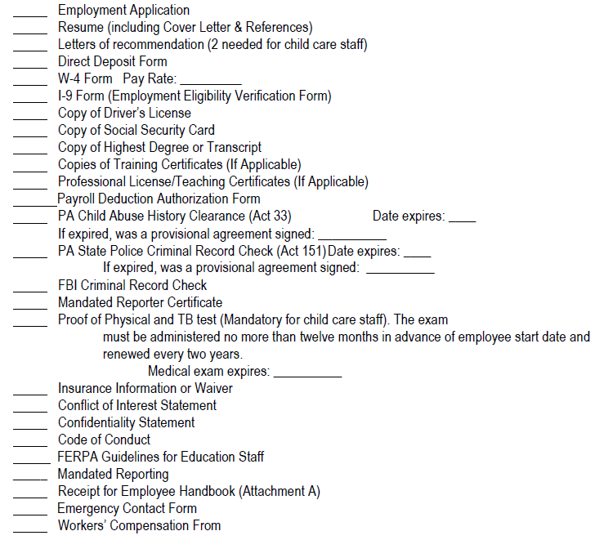
I’m Hired. Now What?
All new employees
must fill out a New
Hire Packet which
includes:

Slide 33
Important Notes
Your first pay cannot be processed until your employee paperwork is complete.
If you need assistance with paperwork, contact Kayla Cobaugh, Human Resources Manager at 814-262-0732 x236 or kcobaugh@thelearninglamp.org.
Employees working directly with children must have all 3 clearances and proof of a physical and TB test within the last year.

Slide 34
Employee Benefits
Medical, Dental and Vision- Full-time and part-time benefit eligible employees and their dependents are eligible for coverage.
Life, Accident and Disability- We offer full- and part-time employees with insurance coverage through voluntary life insurance and short- and long-term disability coverage in case you cannot work due to illness or injury.
Retirement- Full- and part-time employees may contribute to a 403(b) retirement savings plan as soon as they start work.

Slide 35
Employee Benefits
Program Discounts- Any 12-month employee working 30 hours per week or more is eligible for reduced cost tutoring, child care, preschool and summer camp programs.
Professional Development- Employees are offered a variety of trainings to help build professional skills.
Tuition Assistance- Full-time employees may be eligible for help paying for degrees related to their work.
Paid Time Off- Full-time workers are eligible for vacation, personal/sick and holiday time.

Slide 36
Employee Benefits
Flexible Work Schedules- We recognize the importance of flexibility and the need for work/life balance. Employees are able to work with their supervisor to create a flexible work schedule.
Credit Union Access- Employees are able to access low-cost loans and banking services.
Employee Retention Awards- Employees at Keystone STARS centers are eligible for education and retention awards when grant funding is available.

Slide 37
Employee Benefits
Discounted Gym Membership- Employees living in Johnstown are able to join East Hills Recreation in Richland at a greatly reduced cost.
Employee Assistance Program (EAP)- Employees can use this professional counseling service up to 6 times per year at no cost.

Slide 38
Employee Benefits
If you have any questions about the benefits described, please contact us at 814-262-0732 x236 or:
Human Resources Manager Kayla Cobaugh at kcobaugh@thelearninglamp.org
More information is also available in the employee handbook or on the employee portal of our website.

Slide 39
Employee Handbook
The Learning Lamp’s Employee Handbook will be your primary resource for questions regarding your employment at The Learning Lamp.
A paper copy of the handbook is available at the main office and all child care locations.
The handbook is also available on the employee portal of our website.

Slide 40
Employee Handbook
Parts of the handbook include:
Employment
Compensation
Time Off
Employee Benefits
On-The-Job
Leaving The Learning Lamp
Standards for Excellence

Slide 41
Employee Portal
The handbook is always available on the employee portal.
The portal can be accessed on our website. The address is thelearninglamp.org
Click on the Employment tab.
On the left side of the web page, click the Employee Portal button. User name: TLLstaff Password: lightbulb2014

Slide 42
Employment
Employment at The Learning Lamp is a voluntary, at-will employment relationship with no specified period of time.
New employees will receive an offer letter at the time of hire detailing duties, work hours and rate of pay.

Slide 43
Employment
We are an Equal Opportunity Employer
We expect that all relationships among persons in the workplace will be business-like and free of bias, prejudice and harassment.
Employees who experience any of these are encouraged to call our Anonymous Reporting Hotline at 1-877-369-6480.

Slide 44
Employment
Employees are expected to review and comply with the Code of Conduct , Code of Ethics and Conflict of Interest statements.
Employees are expected to treat topics related to daily work and children served in a confidential manner.
Employees are expected to be actively engaged in their work.

Slide 45
Employee Confidentiality
At The Learning Lamp, we take confidentiality seriously.
Employees are not allowed to discuss students outside of the classroom or with anyone not immediately involved with the care or education of a student.
Conversations about students should be kept positive in nature. Noncompliance may result in dismissal.

Slide 46
Employees as Mandated Reporters
All employees of The Learning Lamp are mandated reporters.
If you suspect a child is a victim of abuse or neglect, you are required to report the information to your program director. He or she will help decide how to document and report the incident to the proper authorities.
All employees will be required to take a 3-hour training on being a Mandated Reporter. Please ask your supervisor for details.

Slide 47
Employment
Full- and part-time employees may receive constructive work reviews on the following schedule:
  90-day meeting with feedback from supervisor
  Six month informal work review
  Annual formal work and wage review
  Wages of contracted school-based employees are determined by the school district

Slide 48
Employment
Employees are paid on a bi-weekly basis
Time sheets must be submitted by Monday prior to the date of pay to Monica Purazo at mpurazo@thelearninglamp.org or faxed to 814-262-0837
A list of pay dates is available from your supervisor or on the employee portal
Pay can be directly deposited into your bank account(s)- Maximum of 2 accounts

Slide 49
Employment
If you are sick and not able to attend work, you MUST follow the Attendance Policy provided by your supervisor.
You are required to give at least a 3-hour notice so your shift can be filled. Appropriate staffing ensures quality care and education for the children enrolled in our programs.
Employees MUST speak to someone when calling off - no voicemails, texts or emails.

Slide 50
Questions?
If you have any questions or concerns about your job, you are encouraged to talk with your immediate supervisor.
Address any safety, quality of care or ethical issues immediately.
If you do not receive an adequate or timely answer from your supervisor, contact your department head. A list of managers is provided on the next page.
Remember– We can’t fix problems we don’t know about.

Slide 51
Our Leadership Team
Leah Spangler, Chief Executive Officer
Kathy Josephson, Chief Operating Officer
Emily Theys, Director of Educational Programs
Jona Duppstadt, Director of Educational Programs
Erica Ponczek, Director of Early Learning Programs
Brittany Darr, Director of School Age Programs
Ingrid Kloss, Development Director

Slide 52
Contact Us
The Learning Lamp
2025 Bedford Street
Johnstown, PA 15904
Office: 814-262-0732
Fax: 814-262-0837
thelearninglamp.org
To email: First initial, last name @ thelearninglamp.org. For Ignite, First initial, last name @ igniteedu.org.

